Slide 1
Competitive Programming
11 Nov. 2022
Andrei Novikov

Slide 2
Revise Homework - Overview
Problems from Benelux Algorithm Programming Contest (BAPC) preliminaries 2016 - Link
Tasks:
Focus on tasks that are <= 4.0 or 4.5, and try to solve them.
Take a look at complex task > 4.5 to be aware what to expect in real competition.

Slide 3
BAPC 2016 Pre – Block Game
Block Game (Link)

Slide 4
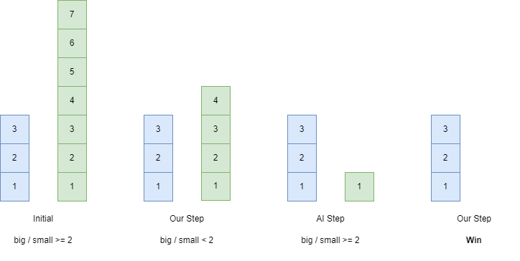
BAPC 2016 Pre – Block Game

Slide 5
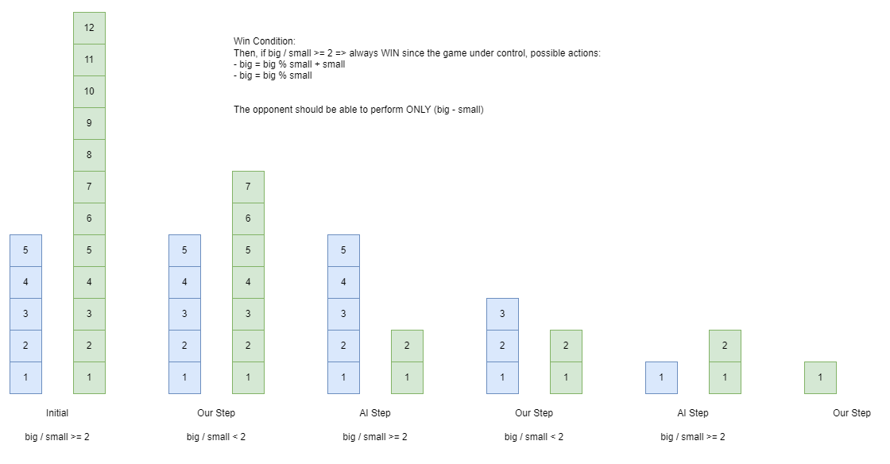
BAPC 2016 Pre – Block Game

Slide 6
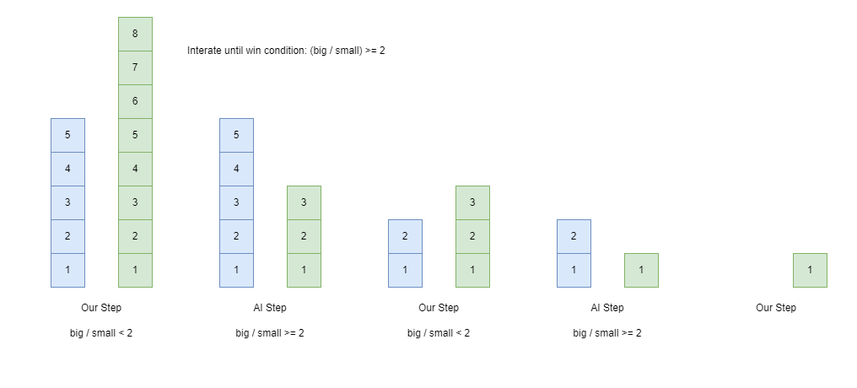
BAPC 2016 Pre – Block Game

Slide 7
BAPC 2016 Pre – Block Game
Block Game (Link)
Solution: Link

Slide 8
BAPC 2016 - Completing the Square
Completing the Square (Link)

Slide 9
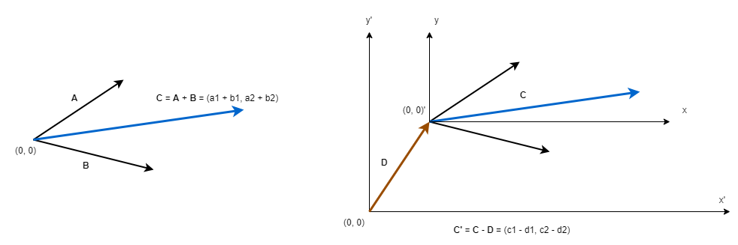
BAPC 2016 - Completing the Square

Slide 10
BAPC 2016 - Completing the Square
Completing the Square (Link)
Solution - Link

Slide 11
BAPC 2016 - Completing the Square
Lost in the Woods (Link)

Slide 12
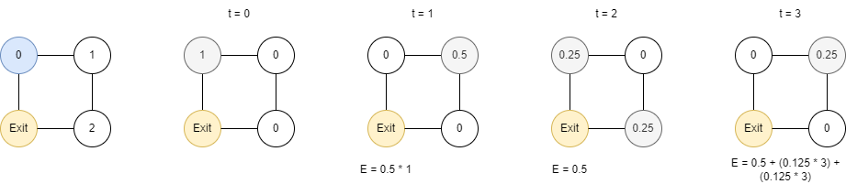
BAPC 2016 - Completing the Square
Lost in the Woods (Link)
Simulate until remaining average time in the woods is not getting less than computation error 10⁻⁵

Slide 13
BAPC 2016 - Completing the Square
Lost in the Woods (Link)
Solution - Link

Slide 14
Homework
Continue consider BAPC 2016 Pre.

Slide 15




Where to Practice
LeetCode [link]
HackerRank [link]
Kattis [link]
TopCoder [link]
Other Resources

